Slide 1
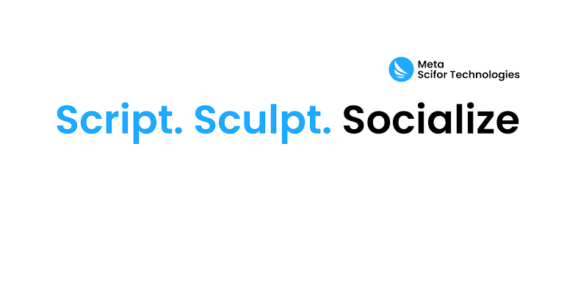


WELCOME TO OUR PRESENTATION ON BUILDING ONLINE TICKET BOOKING SYSTEM
By Akshay Chavan

Slide 2
BUILDING AN ONLINE TICKET BOOKING SYSTEM WITH DJANGO
Introduction
Project overview
Project Setup
Defining Models
Admin Interface
Views and URLs
Templates
Forms and User Input
Authentication and Authorization:
Payment Integration:
Code view
Testing and Deployment
Conclusion

Slide 3
INTRODUCTION
Brief overview of online ticket booking systems.
Importance of having an efficient and user-friendly ticket booking platform.
Introduction to Django as a powerful web framework for building web applications.
Notes:
A Pinterest clone is a website or application that mimics the functionality and features of Pinterest, a popular social media platform known for its focus on visual content discovery and sharing. Pinterest allows users to discover and save ideas for various interests, such as recipes, home decor, fashion, and more, by creating collections called "boards" and "pinning" images or videos to them.

Slide 4


PROJECT OVERVIEW
Summary of the project objectives and scope.
Mention the key functionalities of the online ticket booking system.
Highlight the technologies used (Django, Python, etc.).

Slide 5

Project Setup
Creating a new Django project using django-admin startproject.
Setting up a new Django app using python manage.py startapp.
Explaining the project structure and the role of each file.

Slide 6
DEFINING MODELS
Explanation of models in Django and their role in representing data.
Defining models for the ticket booking system (e.g., User, Event, Booking).
Discussing relationships between models using ForeignKey and ManyToManyField.

Slide 7
Admin Interface
Registering models with the Django admin interface for easy management.
Demonstrating how to use the admin interface to add/edit/delete data.

Slide 8
Views and URLs:
Understanding views and their role in handling user requests.
Creating views for displaying events, booking tickets, etc.
Defining URLs to map views to specific URLs using URL patterns.

Slide 9
TEMPLATES
Introduction to Django's template engine and template inheritance.
Designing HTML templates to render the user interface.
Passing data from views to templates using context.

Slide 10
FORMS AND USER INPUT
Creating forms for user input (e.g., booking details, user registration).
Using Django's form handling mechanism to process form submissions.
Validating user input and handling form errors.

Slide 11
AUTHENTICATION AND AUTHORIZATION
Implementing user authentication using Django's built-in authentication system.
Restricting access to certain functionalities based on user roles.
Ensuring secure user authentication practices.

Slide 12
PAYMENT INTEGRATION
Integrating a payment gateway to handle online payments for ticket bookings.
Discussing popular payment gateway options and their integration with Django.
Considerations for secure payment processing.

Slide 13
TESTING & DEPLOYMENT
Importance of testing in ensuring the functionality and reliability of the application.
Testing Django applications using Django's testing framework.
Deployment options for Django applications (e.g., Heroku, AWS, DigitalOcean).

Slide 14
CONCLUSION
In conclusion, the development of the online ticket booking system using Django has been a fulfilling journey,
showcasing the power and versatility of Django as a web framework. Throughout this project, we have covered various aspects of building a robust and user-friendly ticket booking platform, including project setup, defining models, implementing views and URLs, designing templates, handling user input, integrating authentication and authorization, and exploring payment integration options.

Slide 15
Thank
Thank
Thank
Thank
you!
you!
you!
you!

